Slide 1
Variance

Slide 2


Slide 3
Hypothesis Testing

Slide 4
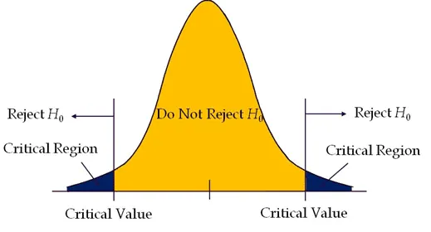

Slide 5
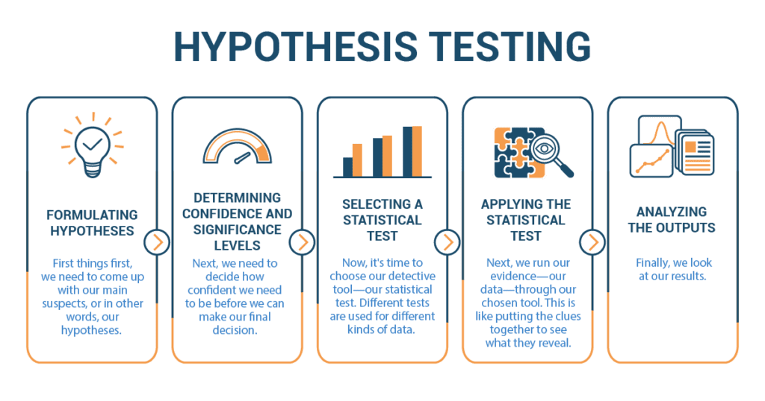

Slide 6
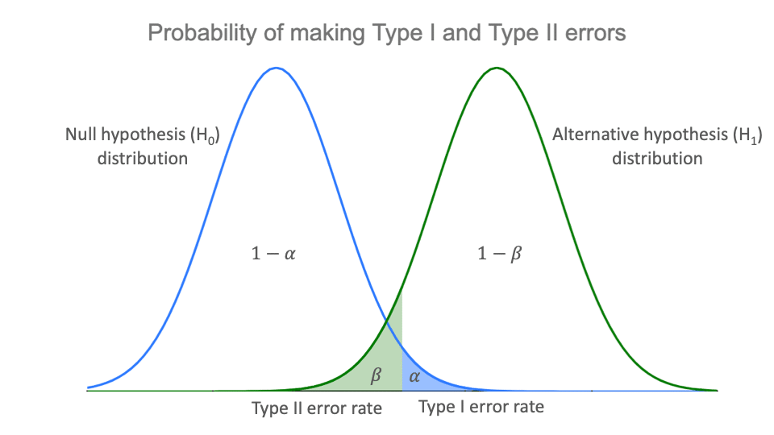

Slide 7
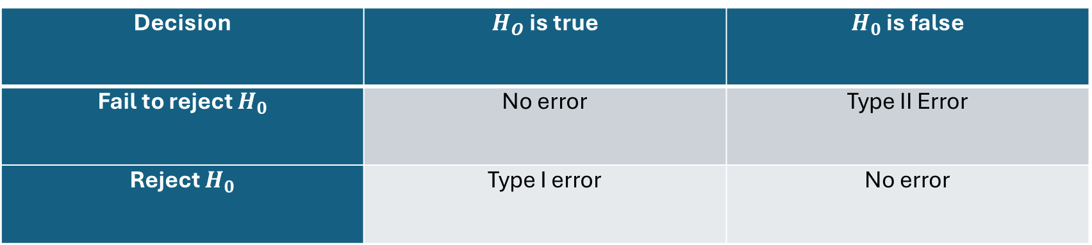
Type I and type II Errors
Decision | $H_{O}$ is true | $H_{0}$ is false
Fail to reject $H_{0}$ | No error | Type II Error
Reject $H_{0}$ | Type I error | No error

Slide 8
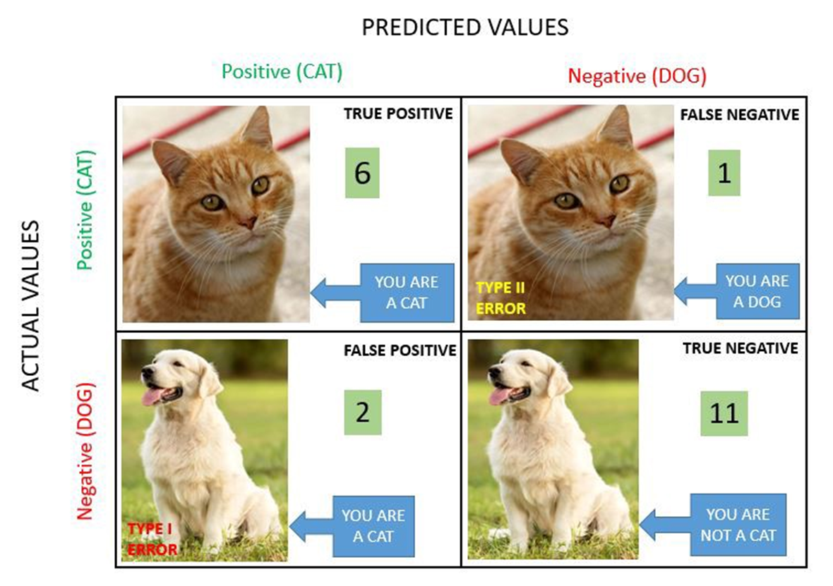

Slide 9
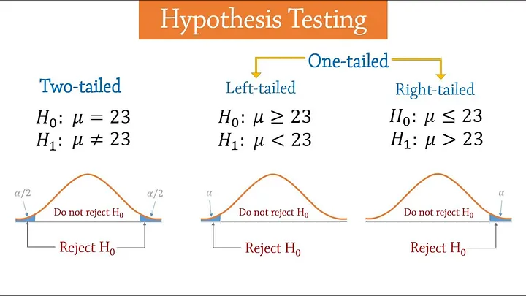

Slide 10
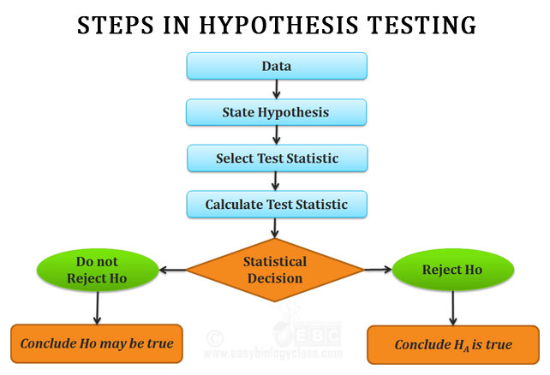

Slide 11
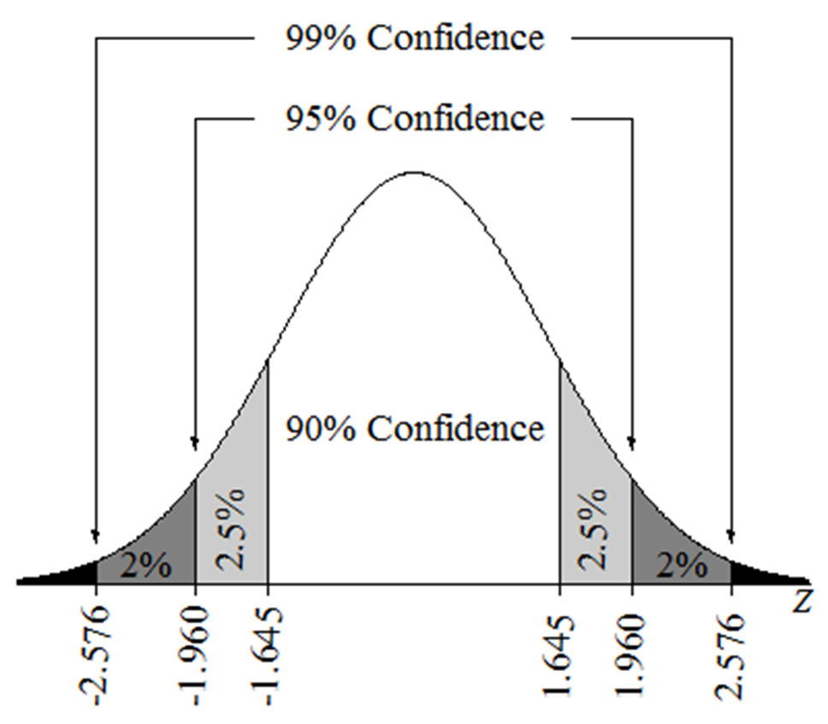
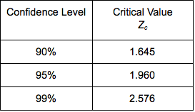

Slide 12
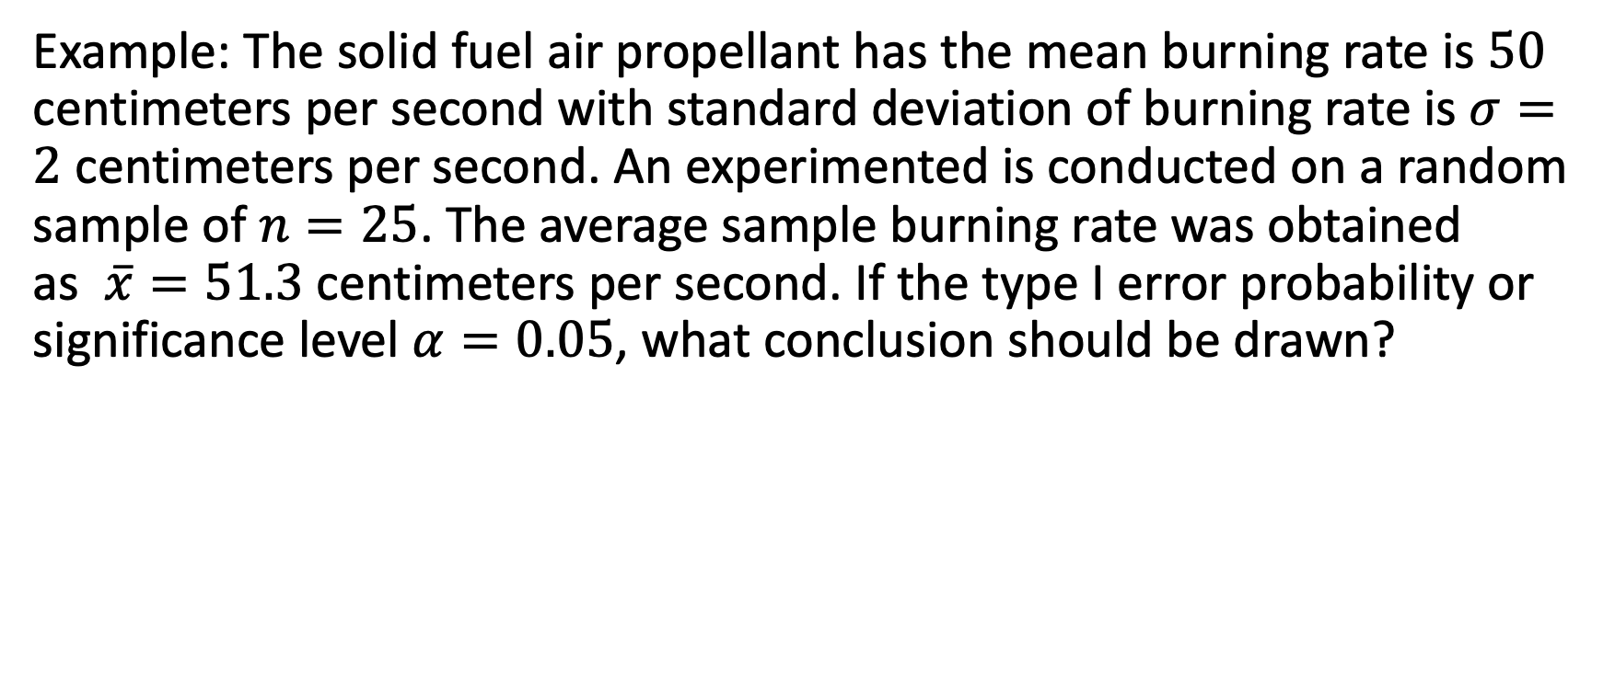
Example
Example: The solid fuel air propellant has the mean burning rate is $50$ centimeters per second with standard deviation of burning rate is $σ=2$ centimeters per second. An experimented is conducted on a random sample of $n=25$. The average sample burning rate was obtained as $\overline{x}=51.3$ centimeters per second. If the type I error probability or significance level $α=0.05$, what conclusion should be drawn?

Slide 13
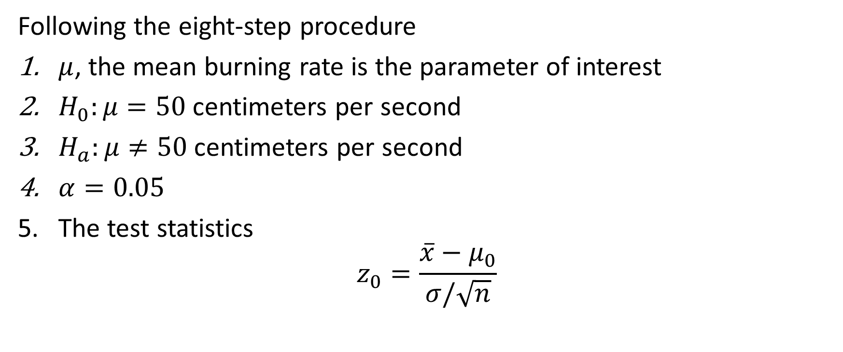
Solution
Following the eight-step procedure
$μ$, the mean burning rate is the parameter of interest
$H_{0}:μ=50$ centimeters per second
$H_{a}:μ≠50$ centimeters per second
$α=0.05$
The test statistics
$$z_{0}=\frac{\overline{x}−μ_{0}}{σ/\sqrt{n}}$$

Slide 14
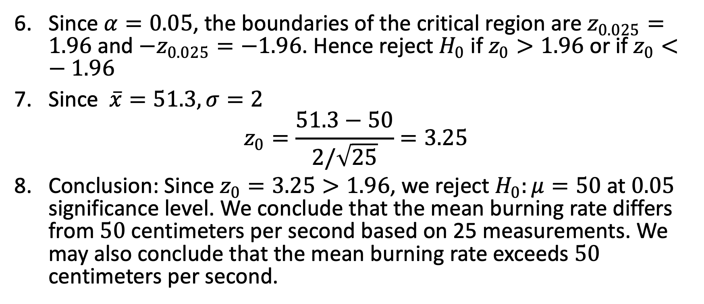
Solution
Since $α=0.05$, the boundaries of the critical region are $z_{0.025}=1.96$ and $−z_{0.025}=−1.96$. Hence reject $H_{0}$ if $z_{0}>1.96$ or if $z_{0}<−1.96$
Since $\overline{x}=51.3, σ=2$
$$z_{0}=\frac{51.3−50}{2/\sqrt{25}}=3.25$$
Conclusion: Since $z_{0}=3.25>1.96$, we reject $H_{0}:μ=50$ at $0.05$ significance level. We conclude that the mean burning rate differs from $50$ centimeters per second based on 25 measurements. We may also conclude that the mean burning rate exceeds $50$ centimeters per second.

Slide 15
P-value

Slide 16
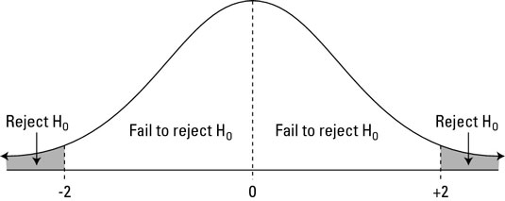
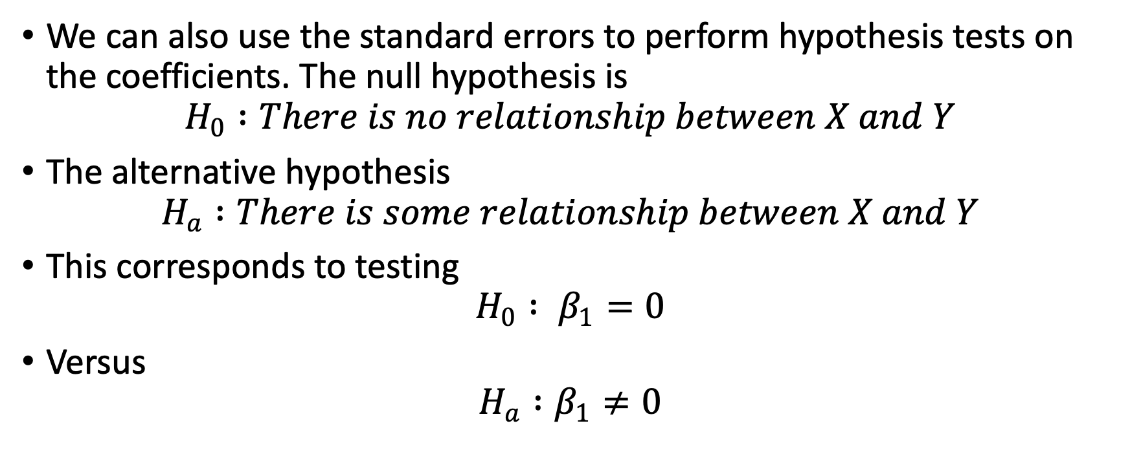
Hypothesis Testing
We can also use the standard errors to perform hypothesis tests on the coefficients. The null hypothesis is
$$H_{0} :There is no relationship between X and Y$$
The alternative hypothesis
$$H_{a} :There is some relationship between X and Y$$
This corresponds to testing
$$H_{0} : β_{1}=0$$
Versus
$$H_{a} :β_{1}≠0$$

Slide 17
What is p-value?
It is an alternative method for rejecting or Accepting the null hypothesis.
It overcomes the problem that if researcher wants to apply the results of the study using different values of alpha(α).
The steps followed are
Probability of the event of interest
Probability of events having same probability as above
Probability of rarer events.
P-value is computed assuming the null hypothesis is true.

Slide 18
P values are expressed as decimals although it may be easier to understand what they are if you convert them to a percentage.
For example, a p value of 0.0254 is 2.54%. This means there is a 2.54% chance your results could be random (i.e. happened by chance). That’s pretty tiny.
On the other hand, a large p-value of .9(90%) means your results have a 90% probability of being completely random and not due to anything in your experiment.
Therefore, the smaller the p-value, the more important (“significant“) your results.

Slide 19
What if I Don’t Have an Alpha Level?
In an ideal world, you’ll have an alpha level. But if you do not, you can still use the following rough guidelines in deciding whether to support or reject the null hypothesis:
If p > .10 → “not significant”
If p ≤ .10 → “marginally significant”
If p ≤ .05 → “significant”
If p ≤ .01 → “highly significant.”
When you perform a statistical test a p-value helps you determine the significance of your results in relation to the null hypothesis.

Slide 20
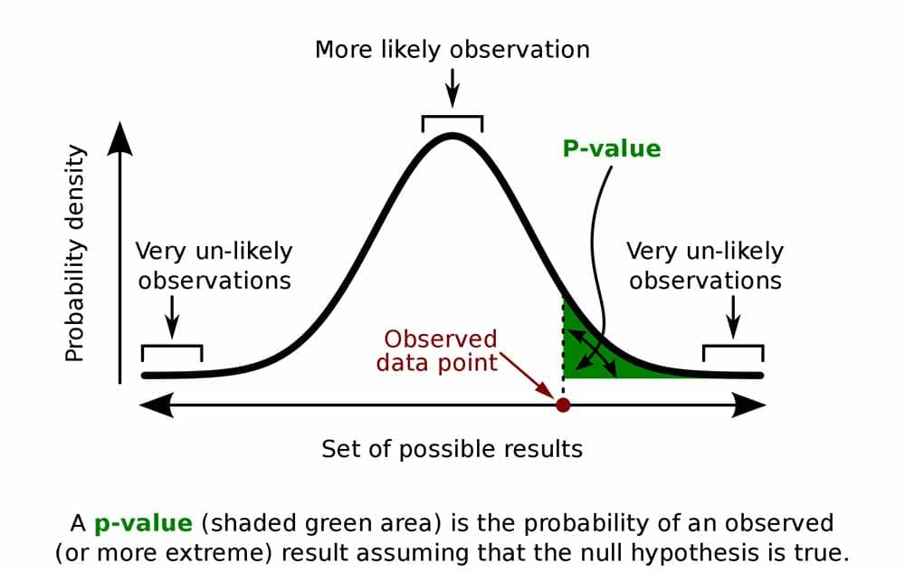

Slide 21
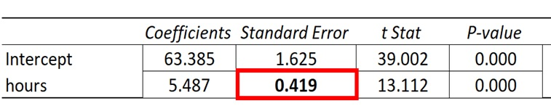

Slide 22
The coefficient for the predictor variable ‘hours studied’ is 5.487. This tells us that each additional hour studied is associated with an average increase of 5.487 in exam score.
The standard error is 0.419, which is a measure of the variability around this estimate for the regression slope.
We can use this value to calculate the t-statistic for the predictor variable ‘hours studied’:
t-statistic = coefficient estimate / standard error
t-statistic = 5.487 / .419
t-statistic = 13.112
The p-value that corresponds to this test statistic is 0.000, which indicates that ‘hours studied’ has a statistically significant relationship with final exam score.
Since the standard error of the regression slope was small relative to the coefficient estimate of the regression slope, the predictor variable was statistically significant.

Slide 23
Tests

Slide 24
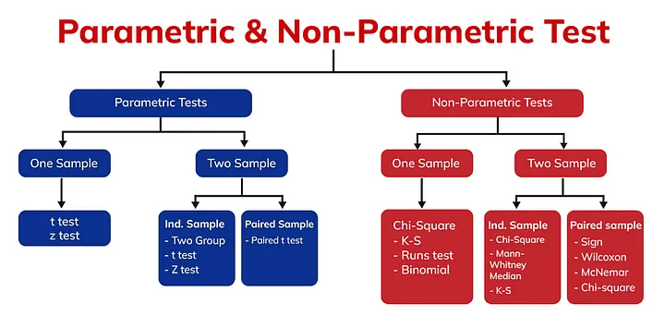

Slide 25
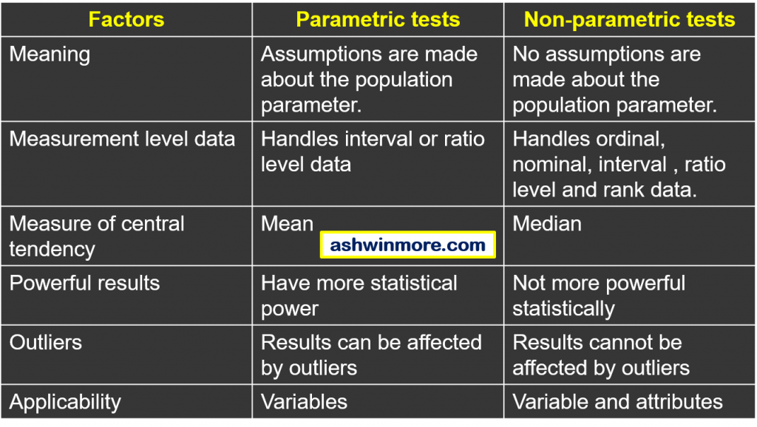

Slide 26
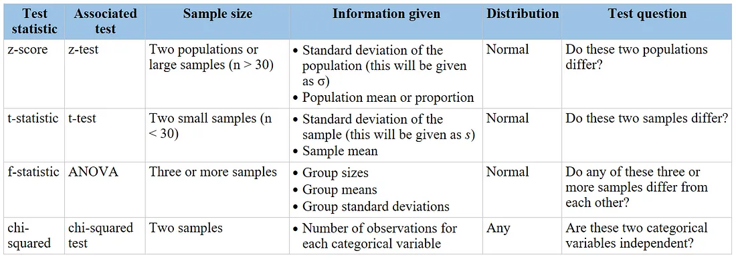

Slide 27
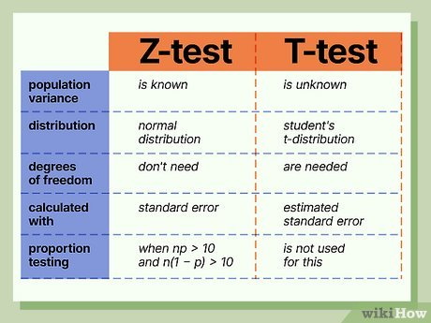

Slide 28
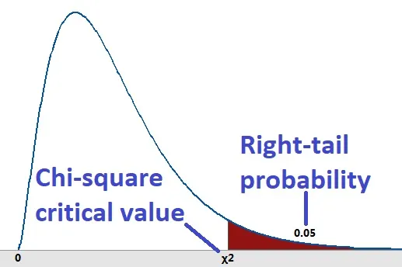
Chi Square
The value of the chi-square random variable χ2 with df=k that cuts off a right tail of area c is denoted χ2c and is called a critical value

Slide 29
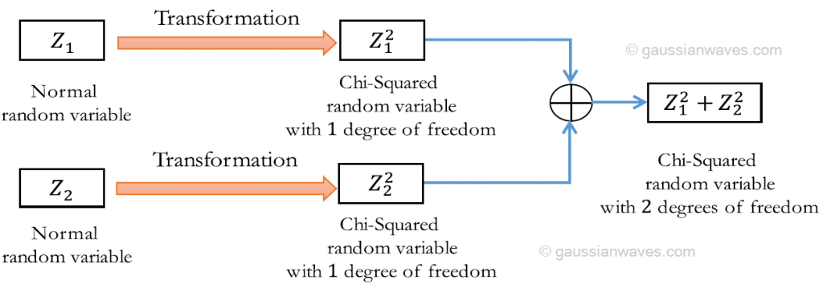

Slide 30
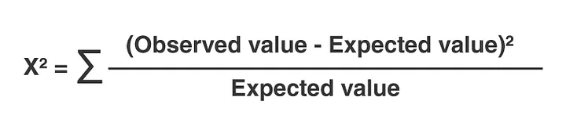
Uses
Chi-square goodness of fit test:
Compares observed frequencies to expected frequencies
Chi-square test of independence:
Determines if there's a relationship between two categorical variables
Machine learning
Used to eliminate irrelevant features and improve model performance
Used to compare observed and expected class frequencies in a confusion matrix
Used to determine the optimal number of bins when converting continuous variables to categorical variables

Slide 31
Properties
A chi-square distribution is a non-symmetrical distribution (skewed to the right).
A chi-square distribution is defined by one parameter: Degrees of freedom (df), v=n–1v=n–1.
A chi-square distribution is the sum of the squares of kk independent standard normally distributed random variables. Hence, it is a non-negative distribution.
For each degree of freedom, there are different chi-square distributions.
The shape of a chi-square distribution changes with the change in the degrees of freedom. The more the degrees of free increase, the more the distribution assumes the shape of a standard normal distribution.

Slide 32
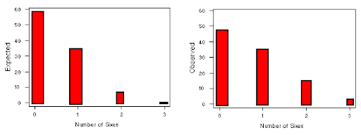
Goodness of Fit
It needs only ‘One Categorical Column’
Here we verify whether the particular categorical column values follow any particular distribution or not.

Slide 33

Test for Independence
It needs ‘Two Categorical Columns’
Here we have Two Categorical Columns, we find whether both columns have any dependency on each other or not.
Ex: does a person's weight have any relationship with a person's age?

Slide 34
ANOVA

Slide 35
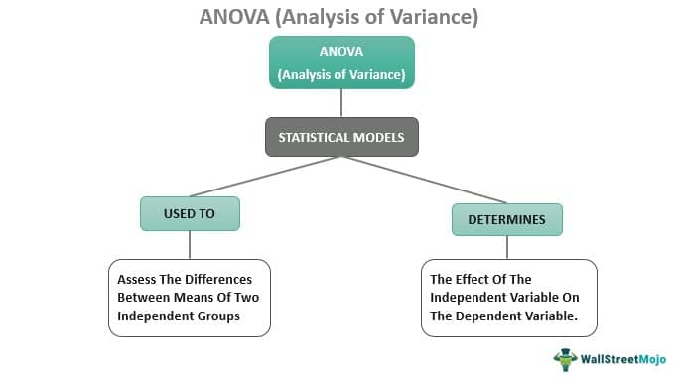

Slide 36
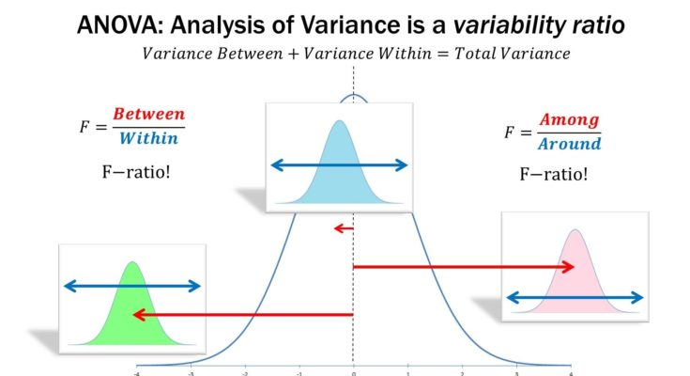

Slide 37
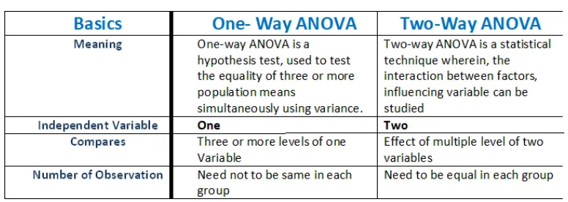

Slide 38
F
Distribution
Test

Slide 39
F-Distribution
The F-distribution, also known Fisher-Snedecor distribution, is extensively used to test for equality of variances from two normal populations.
F-distribution got its name after R.A. Fisher, who initially developed this concept in the 1920s. It is a probability distribution of an F-Statistic.

Slide 40
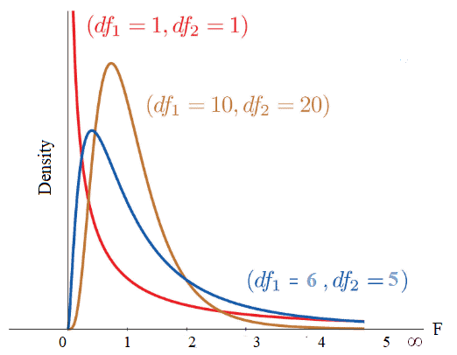

Slide 41
Properties
The F-distribution curve is positively skewed towards the right with a range of 0 and ∞.
The value of F is always positive or zero. No negative values.
The shape of the distribution depends on the degrees of freedom of numerator ϑ1 and denominator ϑ2.
From the above graph, it is clear that the degree of skewness decreased with an increase in the degrees of freedom of the numerator and denominator.

Slide 42
When to use?
The F-test compares more than one level of independent variable with multiple groups, which uses the F distribution.
This is generally used in ANOVA calculations. Always use F-distribution for F-test to compare more than two groups.
Example: In a manufacturing unit, torque values are key parameters in terminal squeeze welding. To check the significant effect of various torque (nm) values of the squeeze welding, an operator set up trials of 5nm, 8nm, 10nm, and 12nm of terminals in four randomly selected batches of 30. ANOVA can determine whether the means of these four trials are different. ANOVA uses F-tests to statistically test the equality of means.

Slide 43
Assumptions
Assumes both populations are normally distributed.
Both populations are independent of each other.
The larger sample variance always goes in the numerator to make the right-tailed test, and the right-tailed tests are always easy to calculate.

Slide 44
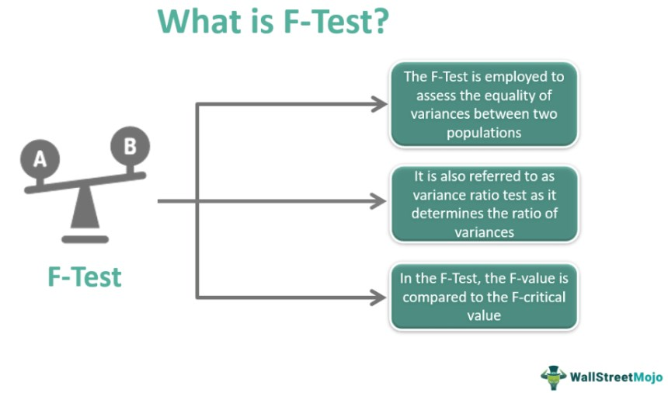

Slide 45
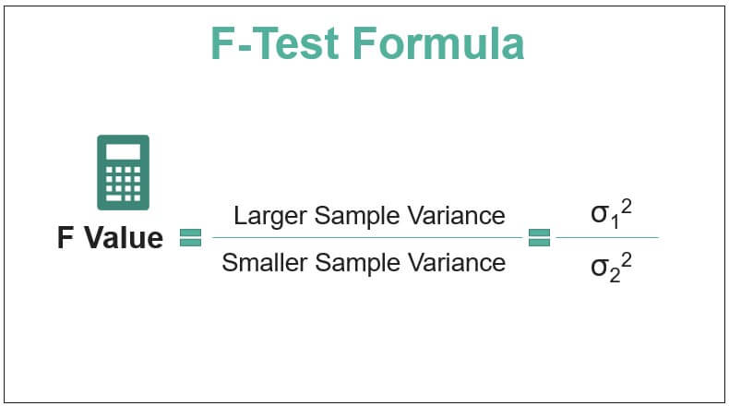

Slide 46
F-Value / Statistic
F-statistic, also known as F-value, is used in ANOVA and regression analysis to identify whether the means between two populations are significantly different or not.
In other words, F-statistic is the ratio of two variances (Variance is nothing but a measure of dispersion; it tells how far the data is dispersed from the mean).
F-statistic accounts for corresponding degrees of freedom to estimate the population variance.

Slide 47
When to use F-test
In statistics, an F-test of equality of variances is a test for the null hypothesis that two normal populations have the same variance.
The F-test tests the equality of several means. At the same time, ANOVA tests the equality of means.
F-tests for linear regression models are to test whether any of the independent variables in the multiple linear regression are significant or not.
It also indicates a linear relationship between the dependent variable and at least one of the independent variables.

Slide 48
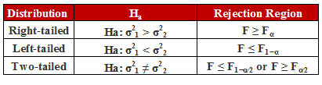

Slide 49
Actual Results

Slide 50
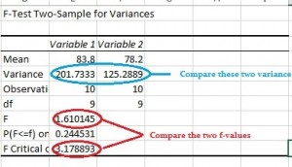

Slide 51
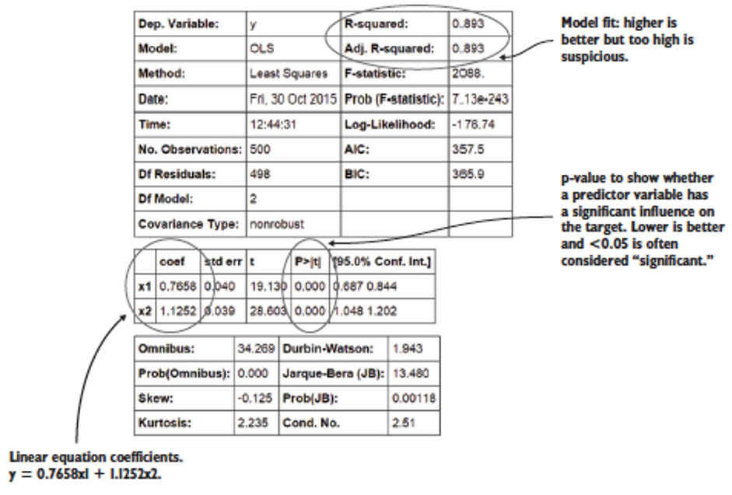

Slide 52
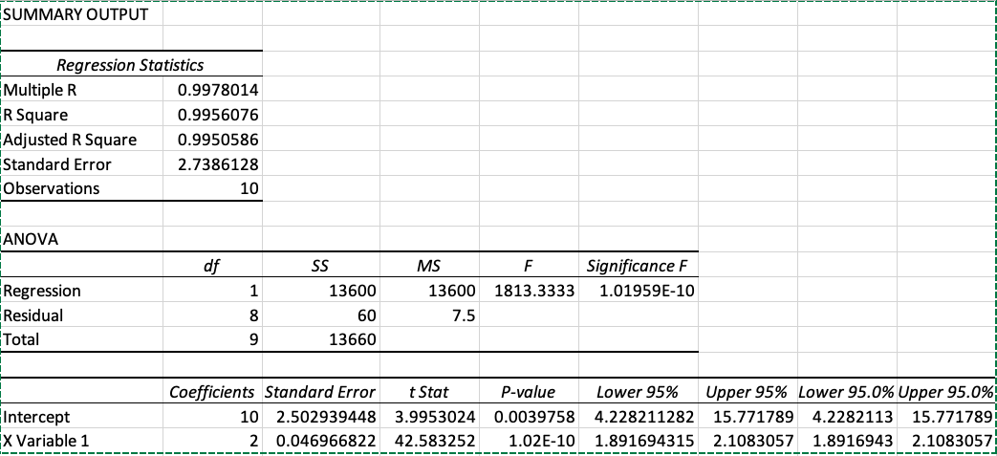
Regression Summary Output

